Slide 1
GROUP 2 AMPOFO GODFRED DIAS BERKTASOV MALIK GABDULIN UML FOR STUDENTS MAP

Slide 2
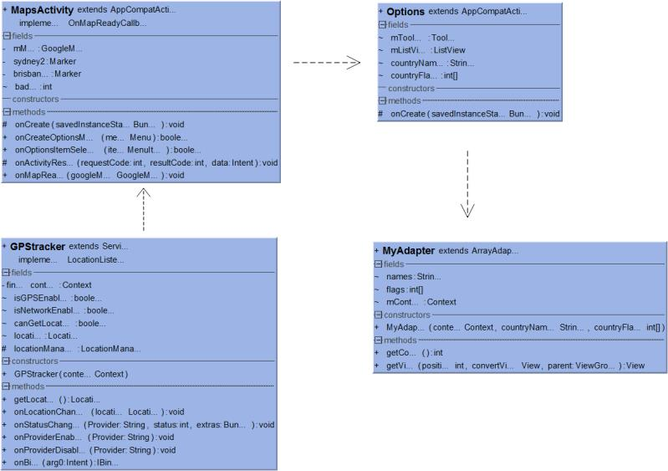
UML CLASS DIAGRAM

Slide 3
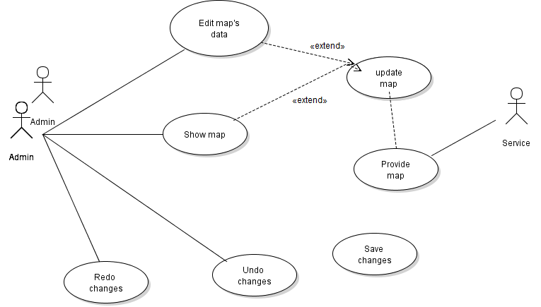
UML USE CASE DIAGRAM

Slide 4
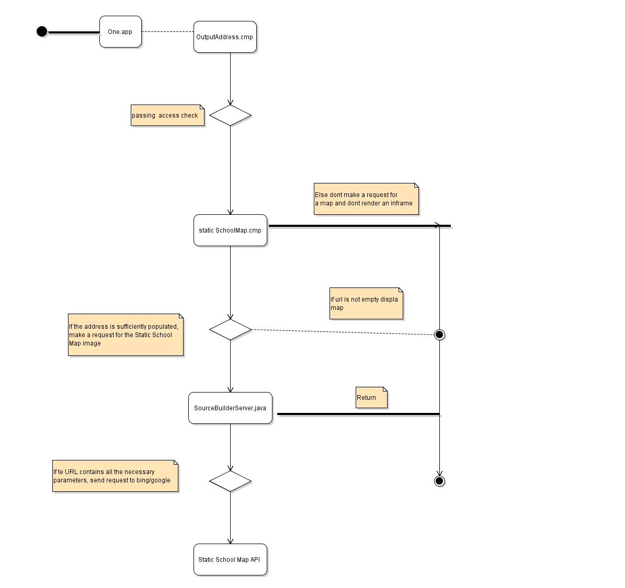
UML ACTIVITY DIAGRAM

Slide 5
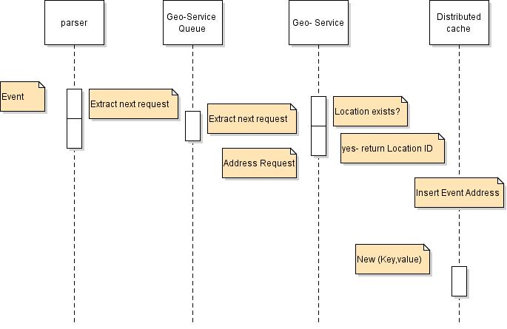
UML SEQUENCE DIAGRAM

